Slide 1
Patient Data Management Using Hyperledger Fabric
By
Team Titanium

Slide 2
Problem Statement
Healthcare systems are complex and the records maintained by the healthcare organizations are usually centralized and the patients have less control over their data. This creates several problems such as
transfer of records,
reliable medical history,
easy access to data,
security
and many more.

Slide 3
Solution
To overcome this problem we are adapting permissioned blockchain technology using Hyperledger Fabric.
Distributed health ledgers will
enable smooth transfer of medical data.
providing reliable medical history on patient.
…

Slide 4
Requirements
Organizations:
Patients
Hospitals/clinic
Peers:
Patients -> patient, emergency contact
Hospitals/clinic -> doctor, laboratory
Smart Contracts: allowAccess() etc.
Confidential Communication: Different channels
Web Interface: Interface for users

Slide 5
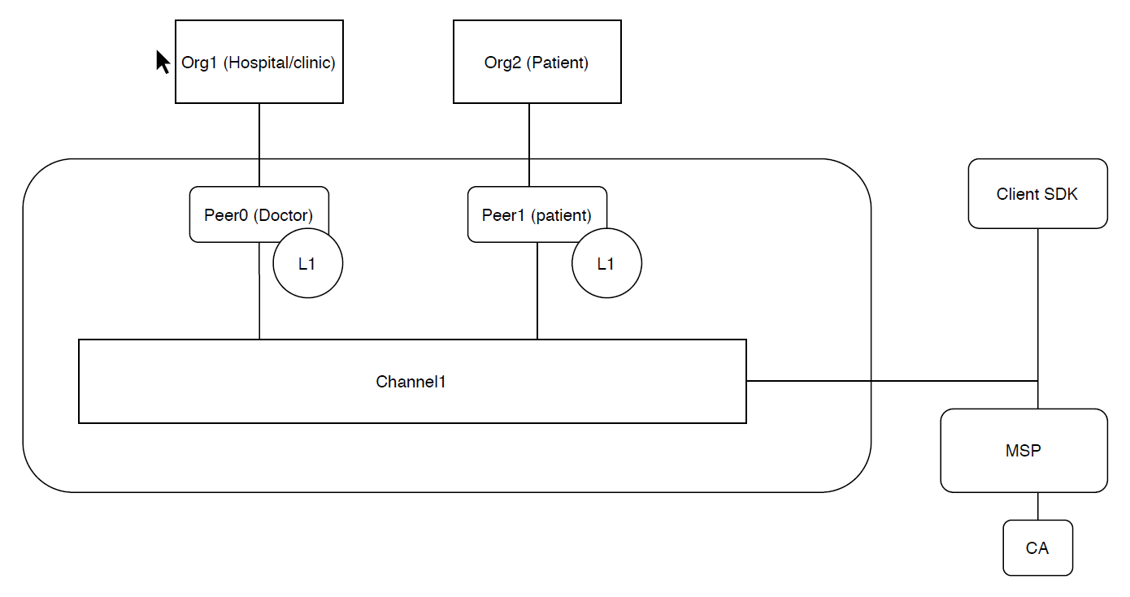
Basic Architecture

Slide 6
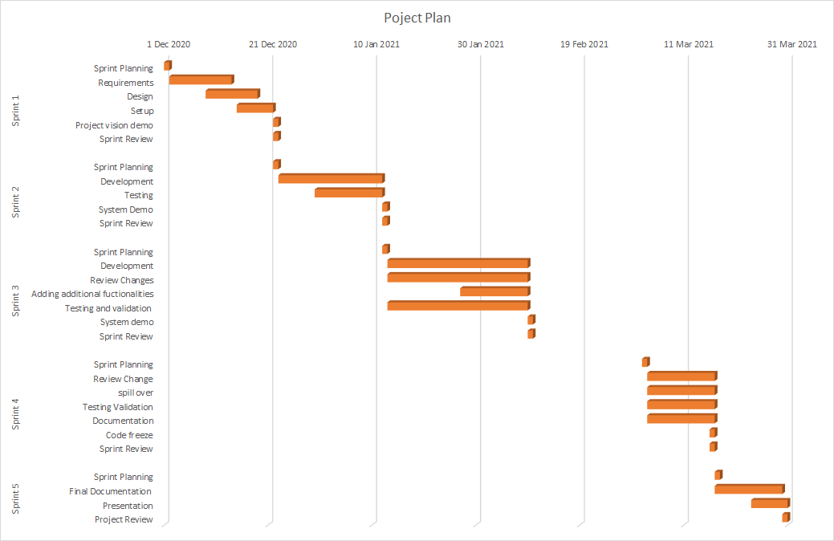

Slide 7
Technology Stack
Smart Contracts: Node.js
Database: Level DB/CouchDB
Frontend: Angular

